Slide 1
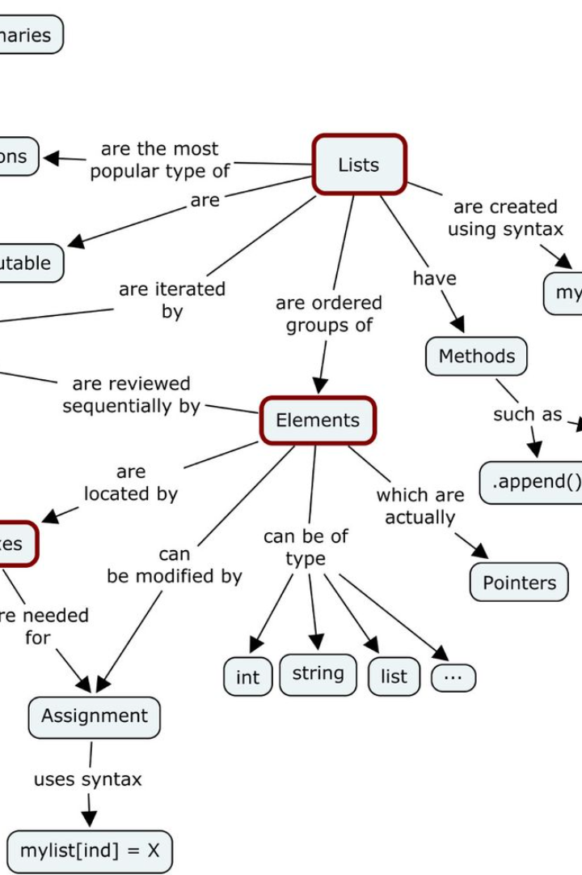
Introduction to Structures in C Language
In the C programming language, a structure is a user-defined data type that allows the grouping of different data types together. This powerful feature enables programmers to create complex data structures to represent real-world entities efficiently.
Structures in C provide a way to organize and store data in a format that suits the specific requirements of a program. They are essential for building larger, more structured applications and are widely used for tasks such as database design and file management.

Slide 2
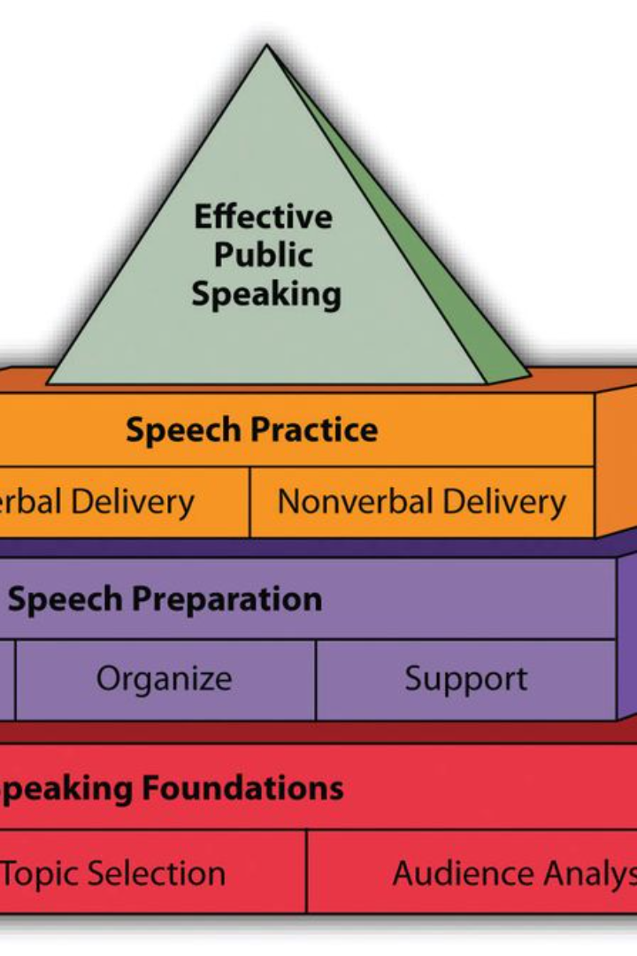
What are structures?
A structure in C language is a user-defined data type that allows us to combine different types of data under a single name. It is used to group variables of different data types which can be accessed as a single unit. This makes it easier to organize and work with related data. Structures are especially useful when dealing with complex data that requires multiple attributes or properties.
Using structures, we can create custom data types to represent entities with distinct characteristics. For example, a structure can be defined to store information about a person, with attributes such as name, age, and address. This versatility makes structures a fundamental concept in C programming, enabling the creation of organized and maintainable code.

Slide 3
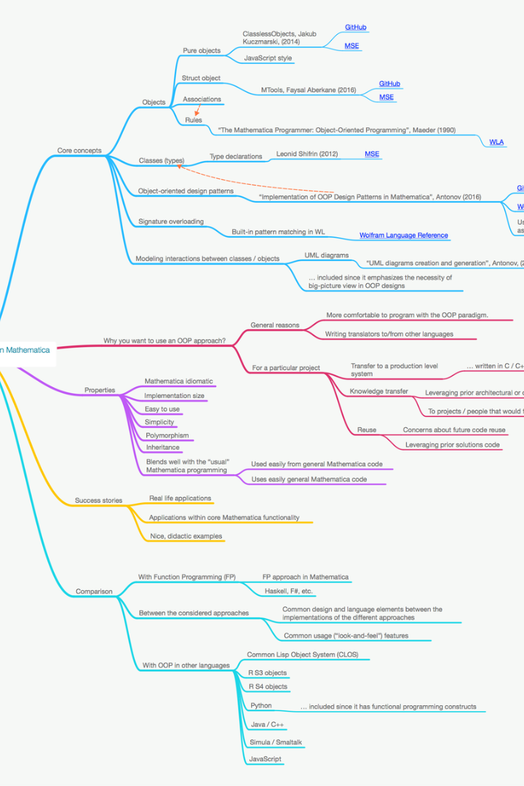
Declaring and defining structures
What is a structure? In the C programming language, a structure is a user-defined data type that allows different data types to be grouped together, similar to a record in other programming languages.
Structure declaration: To declare a structure, the 'struct' keyword is used, followed by the structure name and the definition of its members within curly braces.
Defining structure variables: After declaring a structure, variables of that type can be defined so that memory is allocated for the structure. This is done by specifying the structure name followed by the variable name.

Slide 4
Accessing Structure Members
Direct Access
Pointer Access
Nested Access
When working with structures in C, you can access the individual members of a structure using the dot (.) operator. This allows you to retrieve or modify the values of specific elements within the structure. For example, if you have a structure representing a person with members such as name, age, and gender, you can access and manipulate these members directly.
In addition to direct access, C also supports accessing structure members using pointers. By using the arrow (->) operator, you can access members of a structure through a pointer to that structure. This is particularly useful when working with dynamically allocated memory or passing structures to functions.
Structures in C can also be nested, meaning a structure can contain another structure as a member. When accessing nested structure members, you use the dot (.) operator to access members of the outer structure and the arrow (->) operator to access members of the inner structure through a pointer.

Slide 5
Initializing Structures
Basic Syntax
Designated Initializers
Initializing structures involves setting initial values to the members of the structure. The basic syntax for initializing a structure involves listing the values for each member in a comma-separated list enclosed in curly braces.
C allows for designated initializers, which provide a way to initialize specific members of a structure while leaving the others unchanged. This flexibility in initialization can be particularly useful for large and complex structures.
Array of Structures Initialization
Initializing Nested Structures
When working with arrays of structures, each individual structure within the array can be initialized separately. This allows for unique initializations for each element of the array, providing versatility and adaptability in programming.
In the case of nested structures, the initialization process involves initializing the inner structure members within the outer structure initialization. This ensures that all levels of the nested structure are properly initialized.

Slide 6
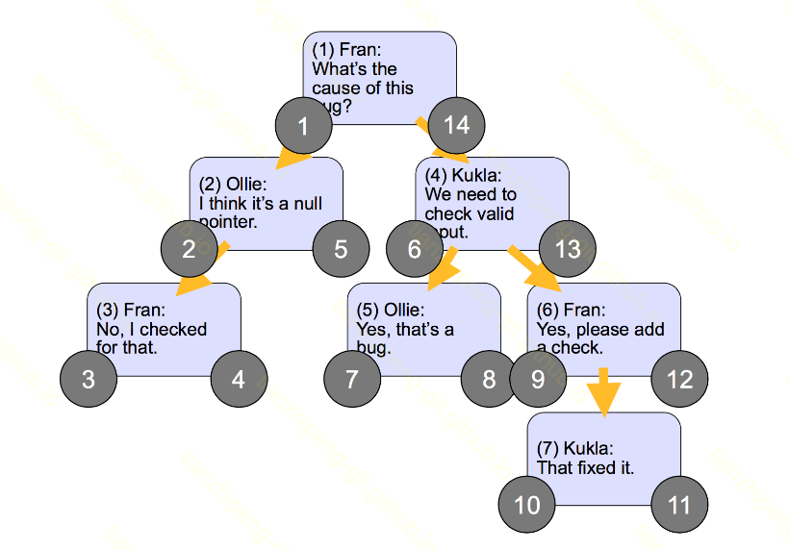
Nested structures
In C language, it is possible to have a structure within another structure, which is known as a nested structure. This allows for the creation of more complex and organized data structures to represent real-world entities or concepts.
For example, a nested structure can be used to model a university, where the outer structure represents the university and the inner structure represents the department within the university. Each department structure can then contain details such as the department name, head of the department, and number of faculty members.

Slide 7
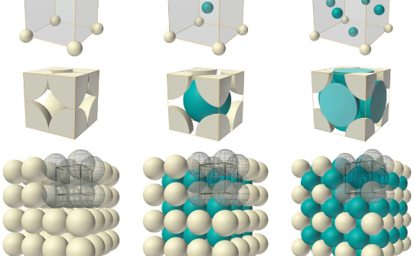
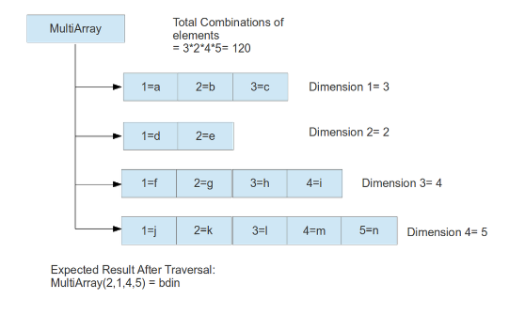
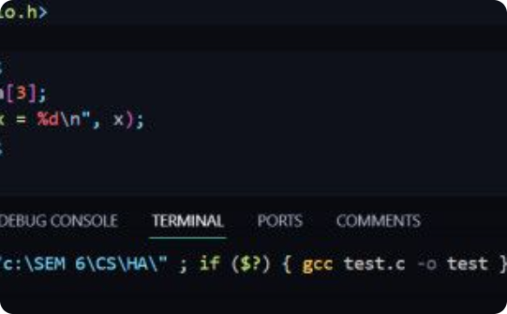
Arrays of structures
Organization of Data
Complex Data Representation
Memory Management
Arrays of structures in C language allow for the efficient organization of related data. This can be particularly useful when dealing with multiple entities that have similar characteristics but distinct values. For example, a database of employees' information can be structured using an array of structures where each structure represents an employee's details such as name, age, and position.
Using arrays of structures enables the representation of complex data sets. This is beneficial in scenarios where there is a need to manage and work with a large amount of interconnected data. For instance, in a financial application, arrays of structures can be employed to store financial records, with each structure containing fields like transaction type, date, amount, and account details.
Understanding the memory allocation of arrays of structures is crucial in C programming. Efficient memory management is essential for optimizing the performance of the program, especially when dealing with large datasets. It's important to consider the memory layout and access patterns when working with arrays of structures to ensure minimal memory overhead and efficient data retrieval.

Slide 8
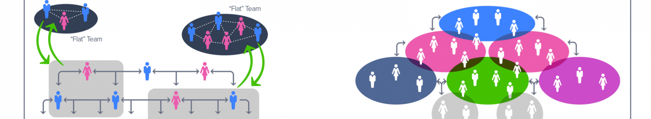



Structures as Function Arguments
Passing Structures to Functions
Accessing Structure Members
Benefits of Passing Structures
One of the key features of structures in C is their ability to be passed as arguments to functions. This allows for the passing of complex data structures, enabling more robust and organized parameter passing in functions.
When structures are passed as function arguments, their members can be accessed within the function using the dot (.) operator. This allows for manipulation and processing of specific elements within the structure.
By passing structures as function arguments, it becomes easier to work with related data sets and maintain a clean and modularized code structure. This practice enhances code readability and promotes reusability and maintainability.

Slide 9
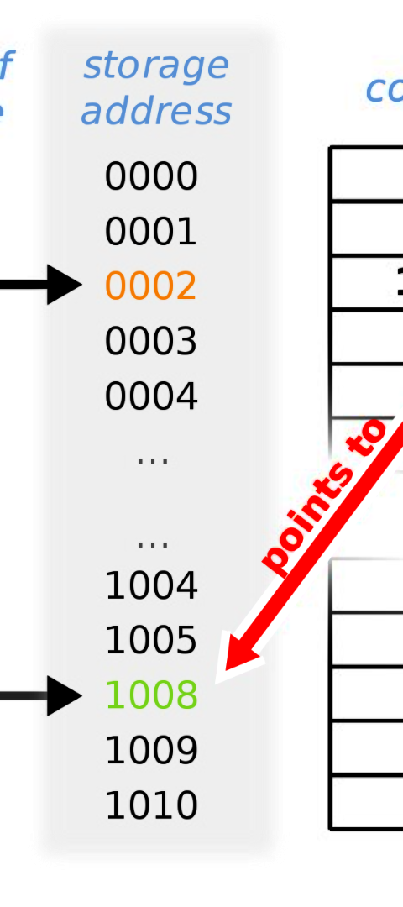
Structures and Pointers
Pointer to Structure
Pointer Arithmetic and Structures
In C language, you can use pointers to manipulate structures. By accessing structure members through pointers, you can directly modify the structure's data, making it a powerful feature for dynamic memory allocation and creating complex data structures.
Pointer arithmetic is used to navigate through an array of structures or a linked list. It involves adding an integer value to a pointer, where the value represents the offset in memory, allowing for efficient traversal and manipulation of structure elements.
Pointers to Structures in Functions
Passing a structure to a function by reference using pointers allows the function to directly modify the original structure, eliminating the need for memory-consuming copying. This makes function calls more efficient, especially for large data structures.

Slide 10

Summary and Conclusion
In this comprehensive exploration of structures in the C language, we have delved into the fundamental concepts, usage, and applications of structures. We started by understanding the basic concept of structures and proceeded to explore the declaration, definition, and accessing of structure members. Additionally, we discussed the initialization of structures, the concept of nested structures, and the use of arrays of structures to manage complex data sets efficiently.
Furthermore, we analyzed the integration of structures as function arguments and their interaction with pointers, providing a versatile toolkit for managing and manipulating data within C programs. This insightful journey enhanced our understanding of structures' role in organizing and accessing data, offering valuable insights and practical applications. As we conclude this exploration, we reaffirm the significance of structures in C language, establishing a solid foundation for proficient programming and data management.

